Slide 1


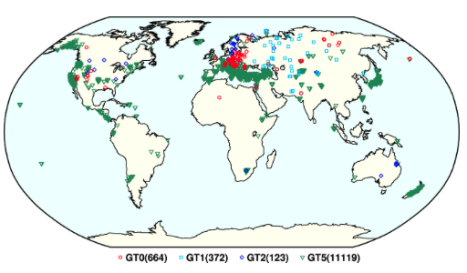
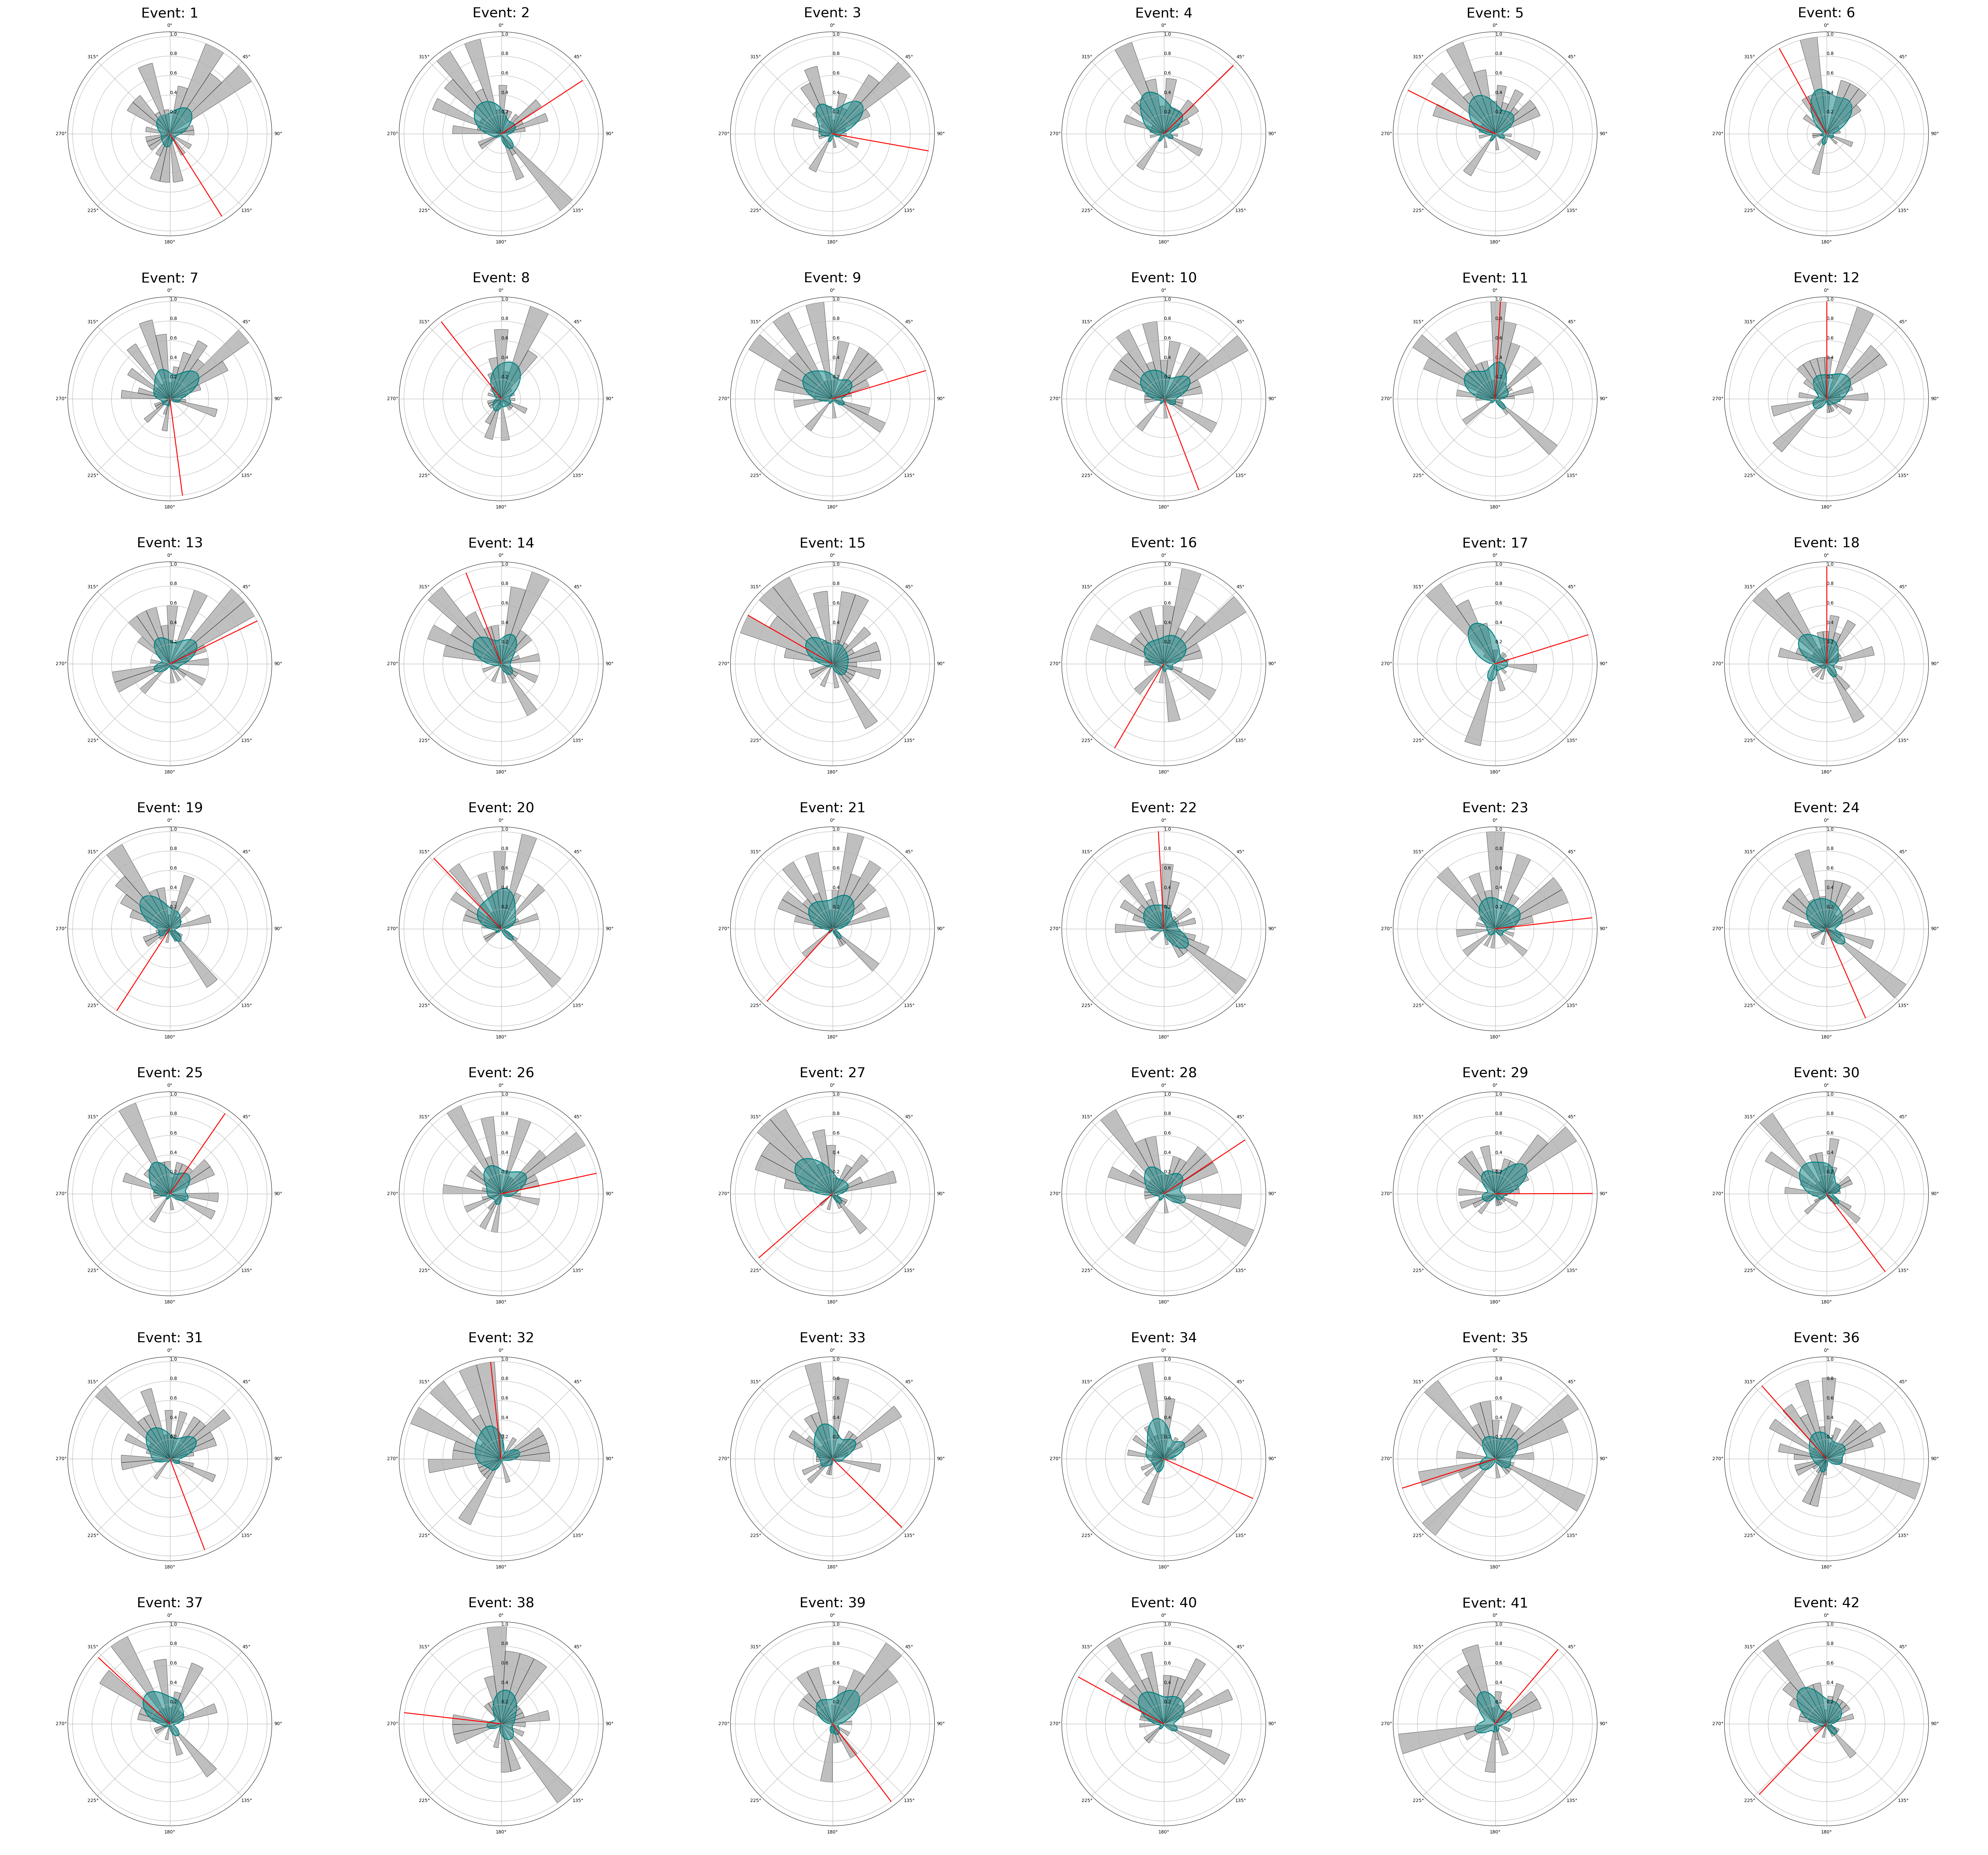
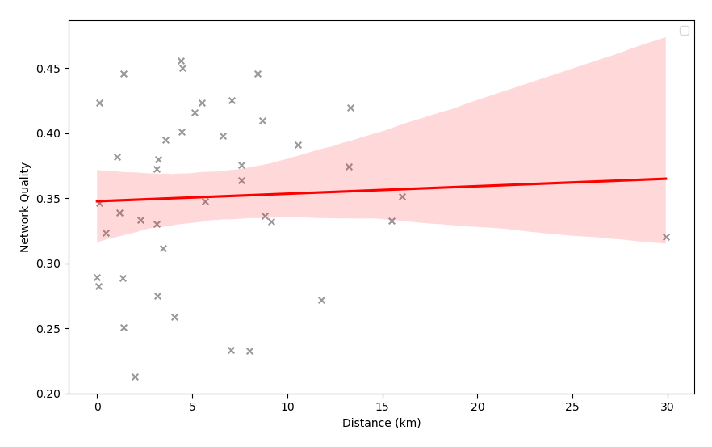
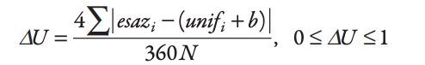
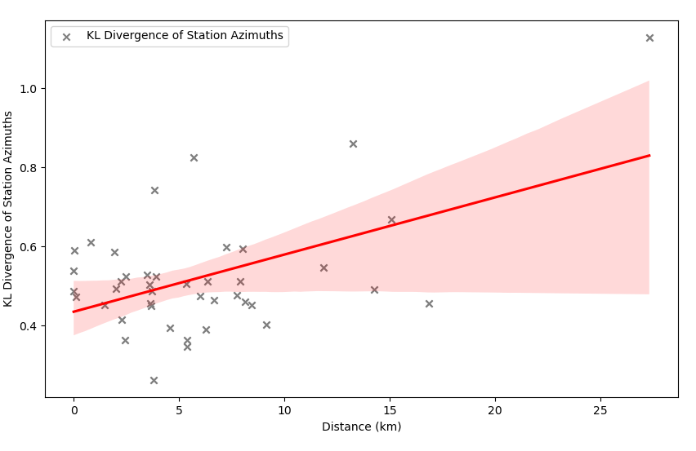
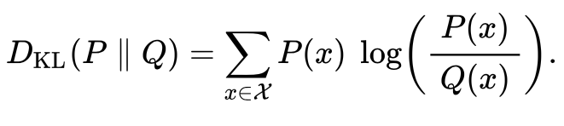
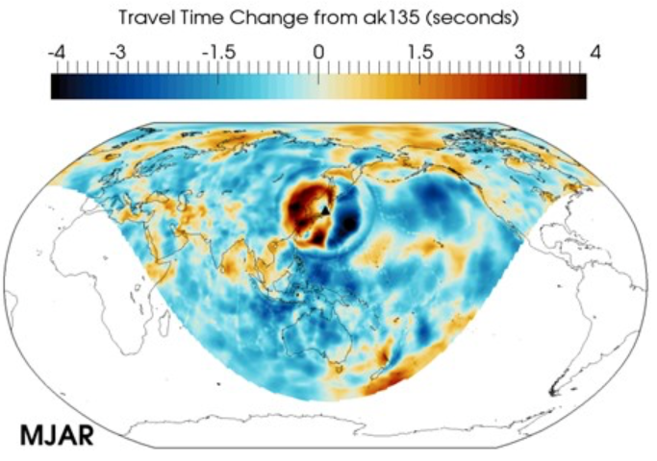
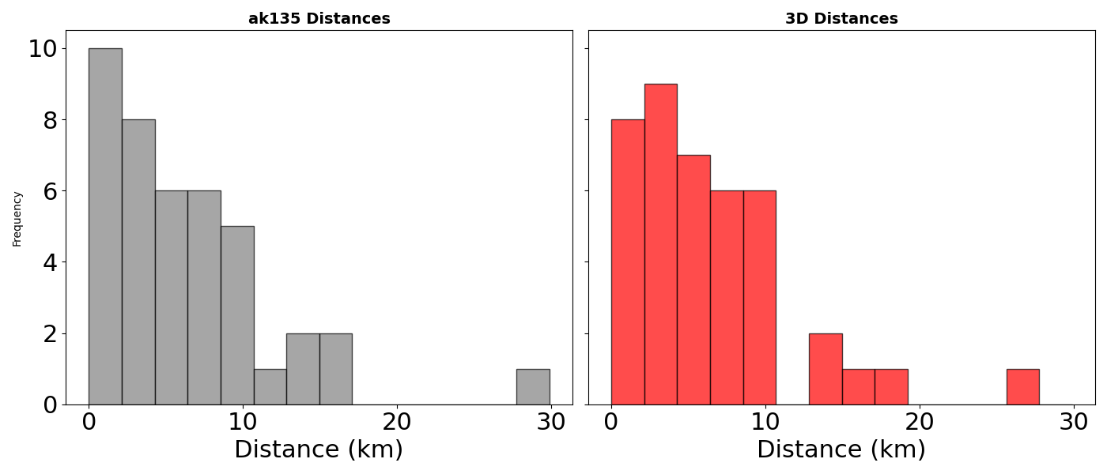
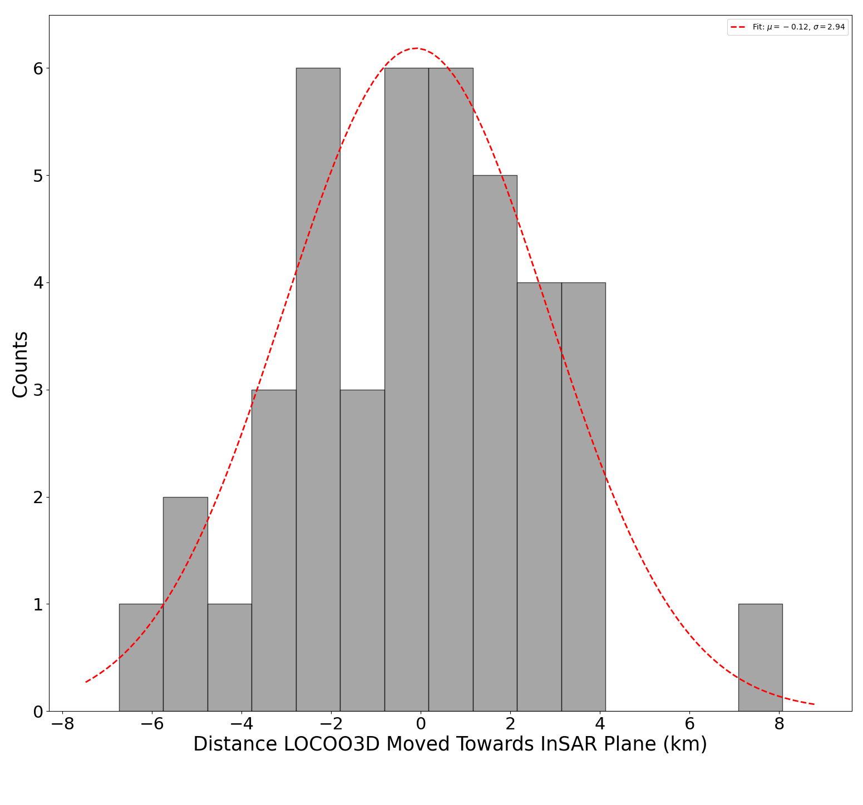
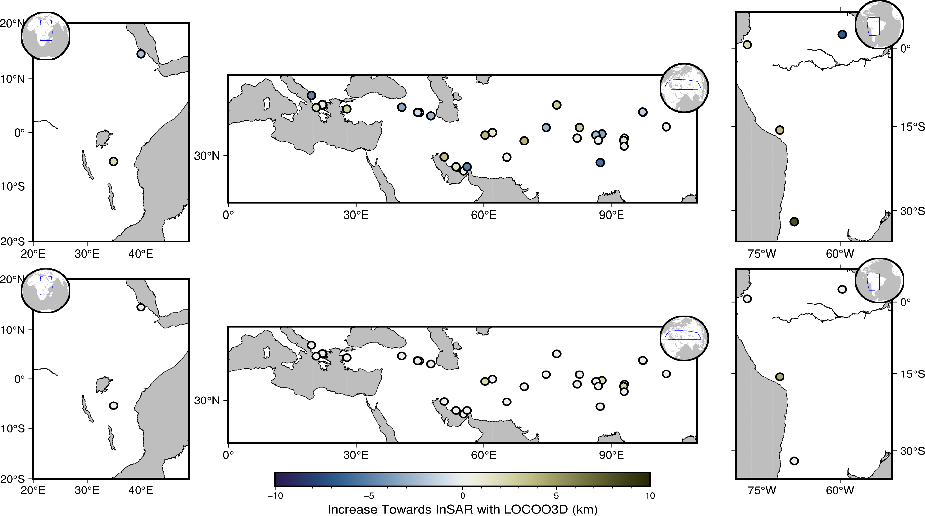
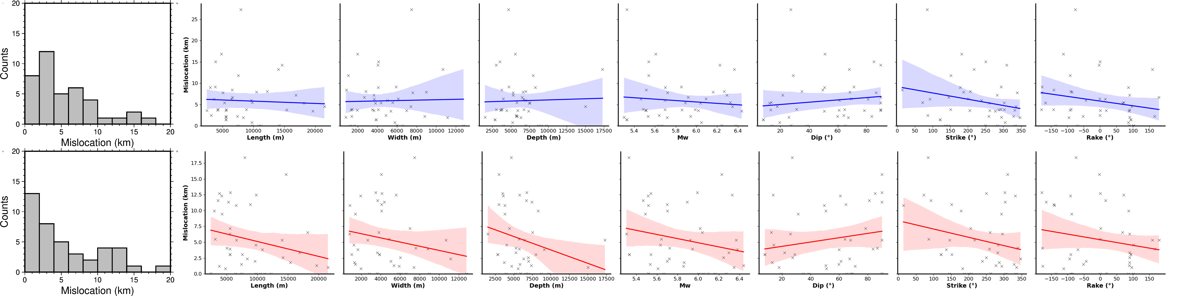
Validation of Seismic Locations With Automated InSAR Source Parameter Estimation.
John Condon^{1,2} (ee18jwc@leeds.ac.uk), John Elliott¹, Susanna Ebmeier¹, Tim Craig¹, Stuart Nippress²
1. Introduction and Motivation
4. Station Distribution
Numerous different global 3D seismic velocity models have been developed.
The validation of each of these models is done via a test set of ground truth (GT) events.
The GT dataset used is sparse, regionally biased and seismically derived.
InSAR source parameter analysis enables independent verification of seismic location methods, using the plane of a uniform slip model as ground truth. With a large InSAR fault plane dataset, improvements gained from using a 3D velocity model in seismic event location can be validated. Improving global seismic location accuracy.
2. Catalog Method
REB results shows no correlation between the station distribution and the angle of mislocation. The amount of mislocation correlates with the KL Divergence but not network quality.
5. 1D vs 3D Velocity Model
SALSA3D, derived from tomographic inversion, consists of 12 million P and Pn travel-time picks from 13,000 stations.
LOCOO3D is a travel-time-based location code that permits the use of both AK135 (1D average velocity model) and SALSA3D.
μ = -0.12,
σ = 2.94
1. Ingest USGS event Info and forward model expected deformation
2. Pull co-seismic interferograms from LICS portal spanning 1 month
3. Deramp, despeckle, GACOS correct, Clip based on USGS expected deformation
4. Mask signal, estimate noise and downsample
5. Run GBIS with a lower sample rate to find new location
6. Repeat steps 3 – 5 with new location.
7. Repeat step 6 with secondary nodal plane
Distance moved towards InSAR plane with SALSA3D (km)
3. Catalog Results
Increase Towards InSAR with SALSA3D (km)
6. Repicking and Error Quantification
Both REB and USGS show mislocation. REB reveals regional mislocation angle bias resulting from either station distribution or 1D velocity model.
A Kagan angle below 60 shows good agreement between USGS mechanisms and the InSAR catalogue.
Repicking the first arrivals moves the solutions closer to the InSAR solution. Once the repicking is completed, the 3D velocity model tends to improve the solution, but only when in areas well constrained in the tomographic inversion events in South America, with 8-degree resolution, do better with a 1D average.
8. Conclusion
First-onset picking has the most significant impact on the mislocation of seismic solutions. Once the pick error is correctly accounted for, 3D velocity models enhance the solution in areas well-constrained by the tomography. For the 42 events tested there was no noticeable overall improvement from using a 3D model in the location until after the events were repicked from the REB picks.
John Condon
University of Leeds¹, AWE Blacknest²
UK Ministry of Defence © Crown Owned Copyright 2025/AWE

